Slide 1

B.Tech Project Evaluation-2, VIIIth Sem
BLOCKCHAIN SUPPLEMENTING MAGNIFICATION OF SECURITY IN SUPPLY CHAIN MANAGEMENT
(BC-022)
PRESENTED BY :-
ANUSHKA SHUKLA [ROLL NO:-180101069]
ABHISHEK KUMAR [ROLL NO:-180102003]
LUCKY KATIYAR [ROLL NO:-180101194]
UNDER THE SUPERVISION OF :-
DR.BHARAT BHUSHAN
SHARDA UNIVERSITY, GR. NOIDA
DEPARTMENT OF COMPUTER SCIENCE AND TECHNOLOGY
School of Engineering and Technology
02,April, 2022

Slide 2
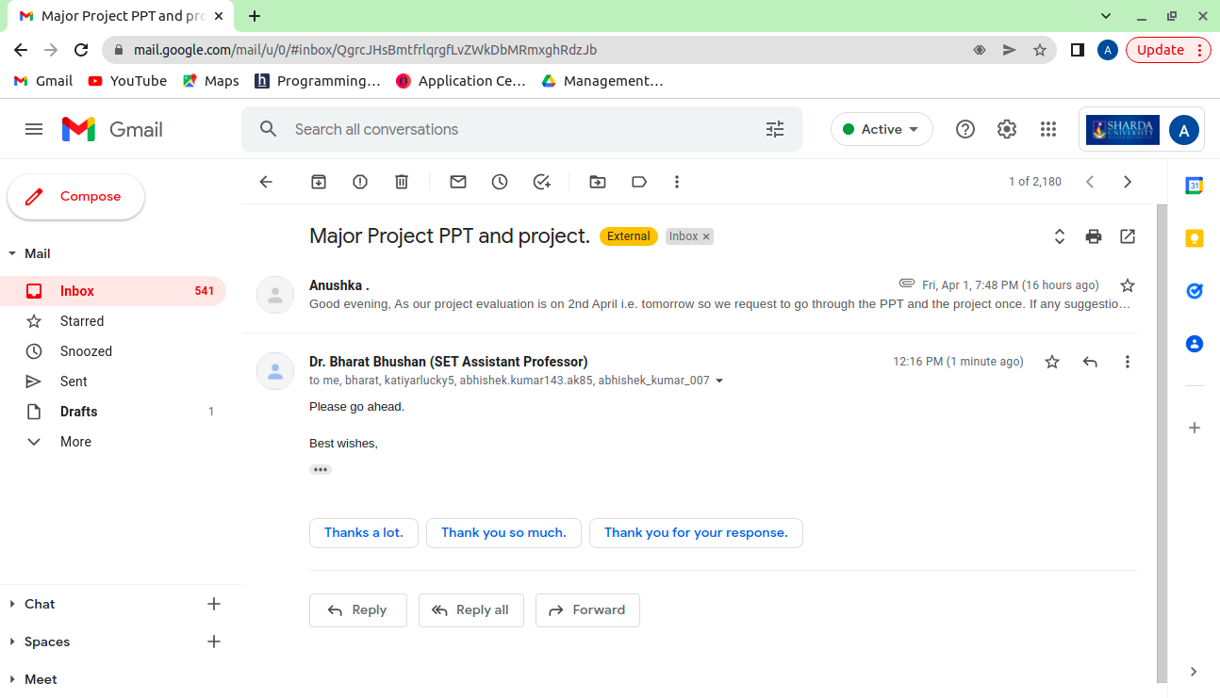
Approval from guide for the evaluation

Slide 3
Contents
Project Overview
Workload Distribution
Improvement/Work done from the last evaluation
Proof of Work
What is Blockchain ?
What Blocks actually are and how they work in blockchain?
What is Supply Chain Management ?
Why is security an important part of supply chain?
How has blockchain improved exchanges in supply chain management?
Project Work
Anatomy of DApp
Working of DApp
Reason behind using DApp
Integration and working of Daap inside SCM
Advantages of BCT enabled SCM using Dapp.
Tech Stack to be used in the project.
What is Metamask?
What is Ganache?
How to create a private network using Metamask?
List of public and private networks
Demo

Slide 4
Project Overview
The transactions that take place in traditional supply chain is prone to data breaches and malicious attacks. So blockchain comes as a solution to this problem by providing a safe and reliable platform to carry out transactions inside a secure network.
So today we will be presenting you how we can process transactions safely using ganache and metamask to buy or to send ETH on a private ethereum network.

Slide 5
Workload distribution of the team
Anushka: Coordinating with team members and the project mentor and managing the tasks. Writing research paper. Setting up the project, writing report and PPT.
Abhishek: Writing research paper. Setting up the project, writing report and PPT.
Lucky: Writing research paper. Setting up the project, writing report and PPT.

Slide 6
Improvement/Work done from the last evaluation
Established our own private network in our local system over ganache framework.
Linked our metamask browser extension to interact with with our private network.
Linked our application with metamask to validate a transaction weather it is valid or not.
We created a decentralised app that carries out the transactions within the established private network using metamask as wallet and its peer-to-peer private network that securely executes and verifies application based transactions.

Slide 7
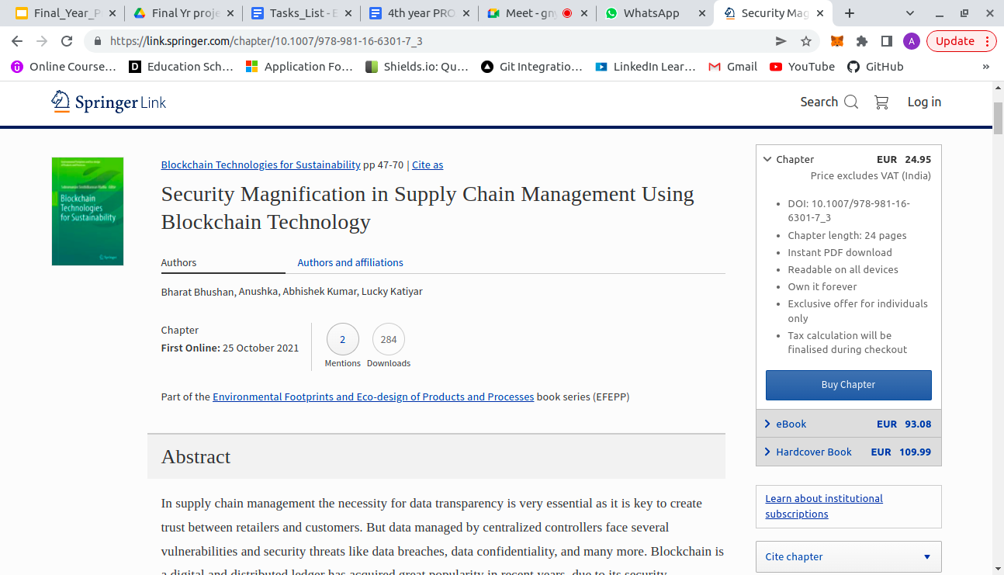
Proof of paper accepted or communicated/ Hackathon/ Patent
Paper Published in Springer Publication:
Security Magnification in Supply Chain Management Using Blockchain Technology | SpringerLink
Project : We’ll demo as we go ahead in this presentation.

Slide 8
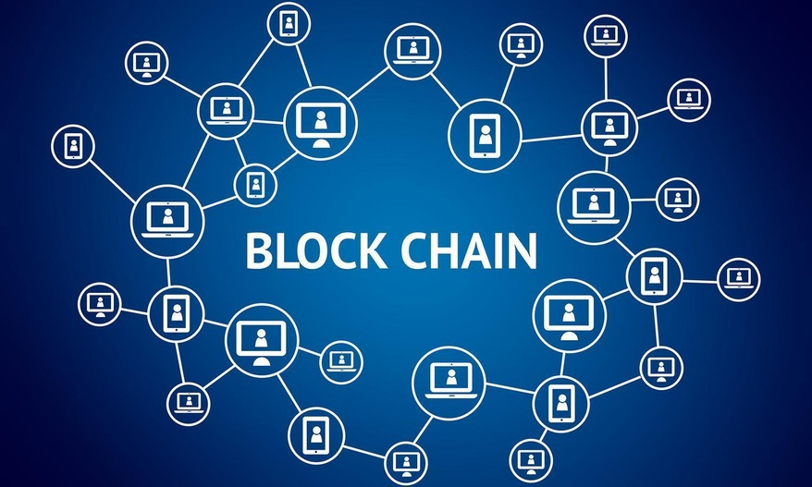
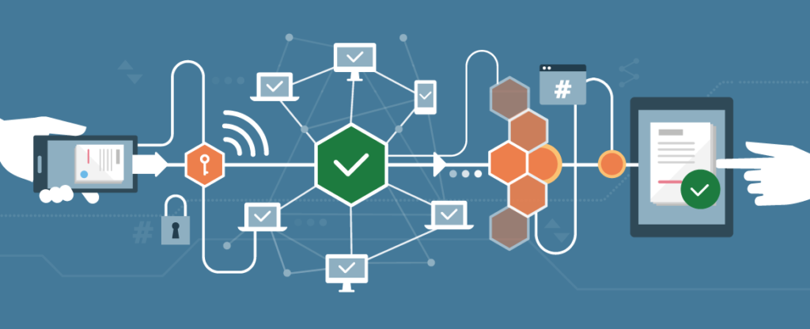
What is Blockchain ?
A blockchain is essentially a digital ledger of transactions that is duplicated and distributed across the entire network of computer systems on the blockchain.
Some key Points of Blockchain
Distributed Ledgers Technology
Immutable Records
Decentralized System
Smart Contracts
Transparency
Traceability
Working of Blockchain
Each block in the chain contains a number of transactions, and every time a new transaction occurs on the blockchain, a record of that transaction is added to every participant’s ledger.

Slide 9
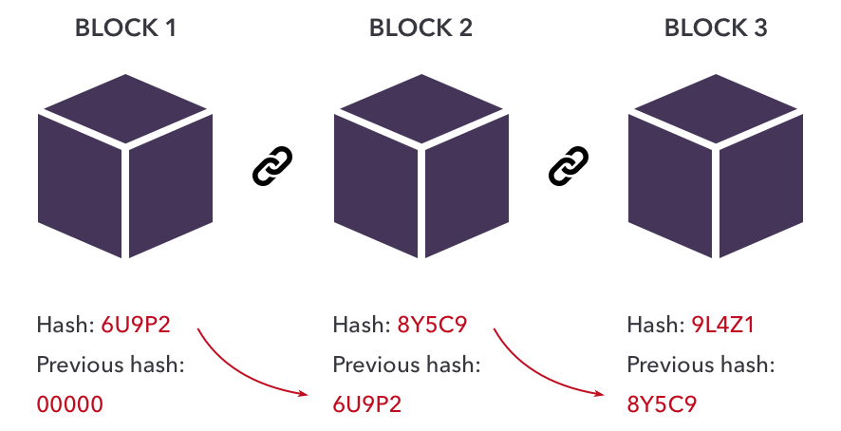
What Blocks actually are and how they work in blockchain?
Every chain consists of multiple blocks and each block has three basic elements:
The data in the block.
A 32-bit whole number called a nonce. The nonce is randomly generated when a block is created, which then generates a block header hash.
The hash is a 256-bit number wedded to the nonce. It must start with a huge number of zeroes (i.e., be extremely small).
Hash
of Previous Block
Data
Hash
of this Block
Notes:
Why is security an important part of supply chain?

Slide 10
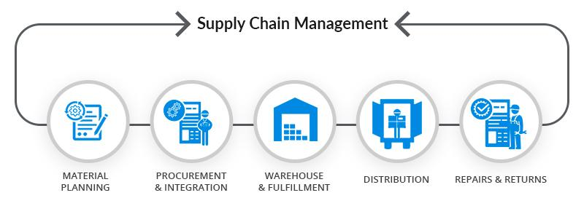
What is Supply Chain Management ?
Supply Chain Management (SCM) is the handling of the flow of products, goods and services, including every process that transforms raw materials into a final product. Traditionally, SCM seeks to cater consumer's demands for a service or product along with the slightest inventory required for the retailer and producer.

Slide 11

Why is security an important part of supply chain?
Supply chains are all about getting customers what they need at the right price, place and time. Any disruptions and risk to the integrity of the products or services being delivered, the privacy of the data being exchanged, and the completeness of associated transactions can have damaging operational, financial and brand consequences.
Five supply chain security concerns:
Data protection
Data visibility and governance
Fraud prevention
Third party risk
Data locality
Data breaches, ransomware attacks and malicious activities from insiders or attackers can occur at any tier of the supply chain. Even a security incident localized to a single vendor or third-party supplier, can still significantly disrupt the “plan, make and delivery” processes.

Slide 12

Supply chain security is a multi-disciplinary problem, and requires close collaboration and execution between the business, customer support and IT organizations, which has its own challenges.
The most important strategies organizations are pursuing to manage and mitigate supply chain security risk:
Vulnerability mitigation and penetration testing
Digitization and modernization
Data identification and encryption
Permissioned controls for data exchange and visibility
Trust, transparency and provenance
Third-party risk management
Incident response planning and orchestration
Security strategy assessments

Slide 13
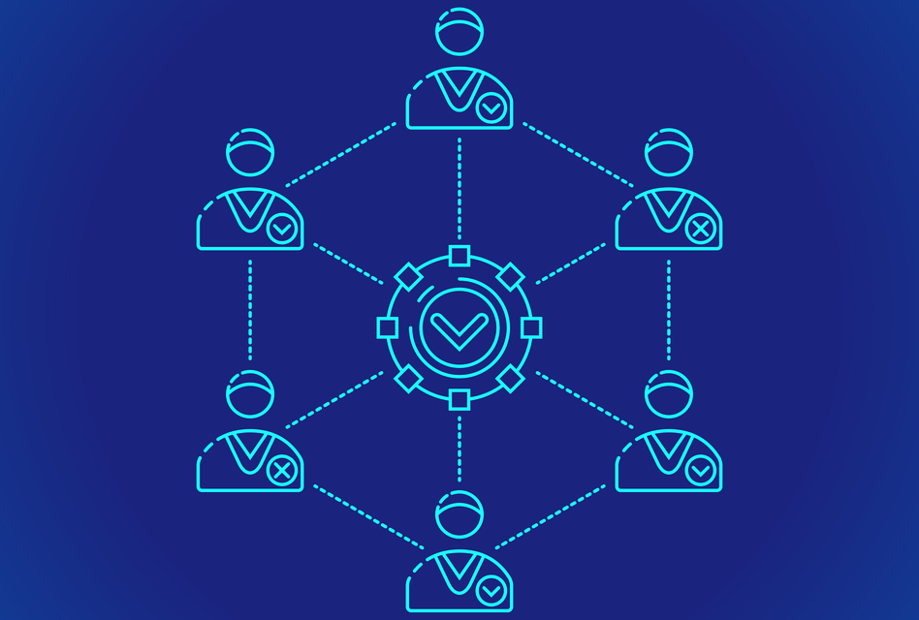
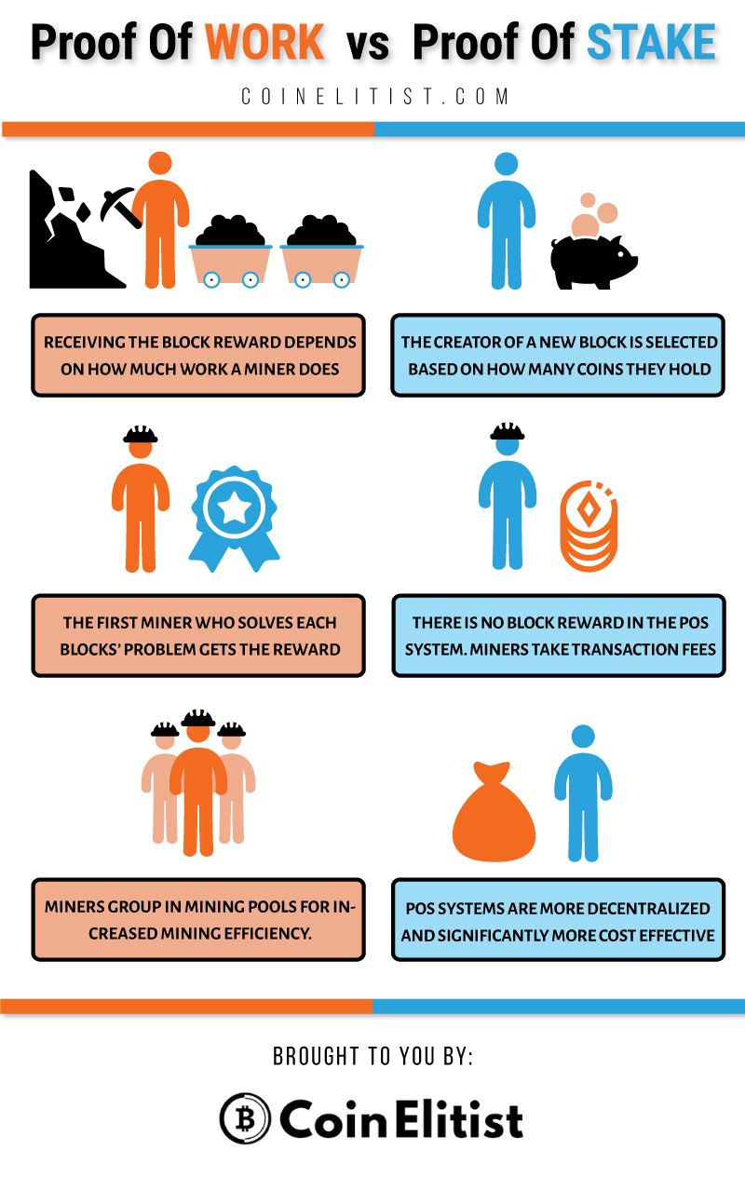
How has blockchain improved exchanges in supply chain management?
Blockchain technology enables efficient ownership and licensing. Verifying past ownership through standardized licensing procedures is vital for numerous industries. Additionally, blockchain can be utilized to accurately license services, products, and software through the use of automated smart contract payments.
Consensus protocols:
Consensus protocols form the backbone of blockchain by helping all the nodes in the network verify the transactions. Bitcoin uses proof of work (POW) as its consensus protocol, which is energy and time-intensive.
Proof of Work:
Proof of Work is the original consensus algorithm in a blockchain network. The algorithm is used to confirm the transaction and creates a new block to the chain. In this algorithm, minors (a group of people) compete against each other to complete the transaction on the network.

Slide 14
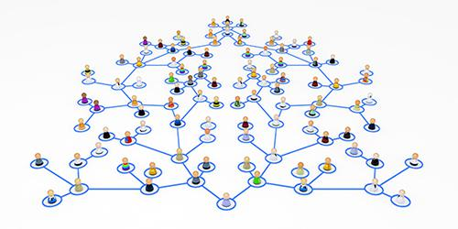
Project Work
1. Creating a DApp
A decentralized application (DApp) is an application built on a decentralized network that combines a smart contract and a frontend user interface. It is a piece of software that communicates with the blockchain, it manages the state of all network. The interface of the decentralized applications does not look any different than any website or mobile app today. The smart contract represents the core logic of a decentralized application and lives inside of blockchain.
Features of Dapp
Open Source
Internal Currency
Decentralized Consensus
No Central Point of Failure
Highly Secure

Slide 15
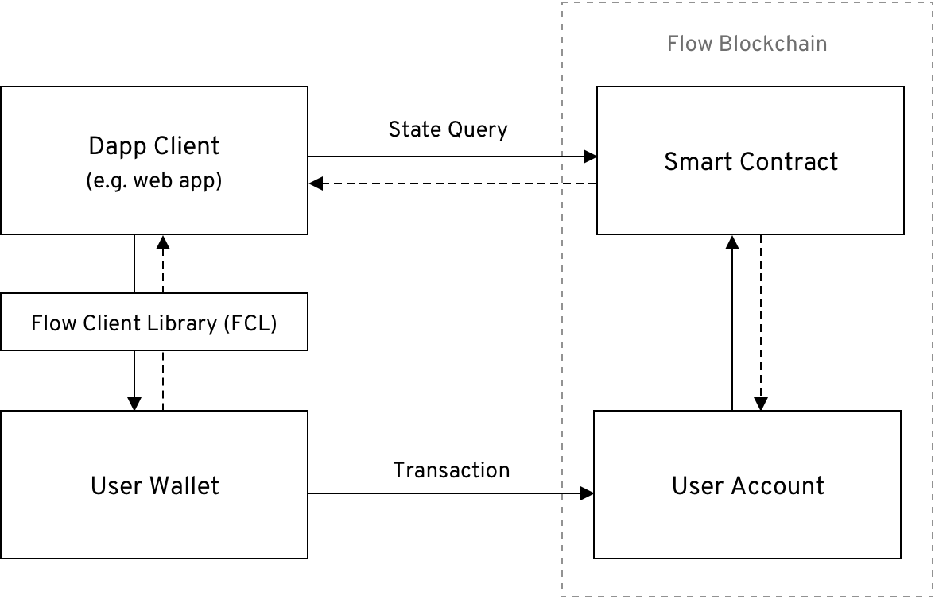
Anatomy of DApp

Slide 16
Dapp Client
The dapp client is the interface through which users interact with your dapp. Web and mobile applications are common examples of dapp clients.
Smart Contract
A smart contract is a collection of code, deployed to a permanent location on the blockchain, that defines the core logic for a dapp.
User Account
A user account is a record on the blockchain that stores the digital assets owned by a single user.
Transaction
A transaction is a piece of code submitted to the blockchain that mutates the state of one or more user accounts and smart contracts. All transactions originate from at least one user account. In most cases, a transaction passes data between a user account and a smart contract.

Slide 17
State Query
A state query is a request made to the blockchain that returns information about the state of your dapp’s smart contracts.
User Wallet
A user wallet is software or hardware that controls access to a user’s account on the blockchain. The application client typically connects to the user’s wallet in order to send transactions to the blockchain. In many cases, the dapp physically transmits the transaction to the blockchain on behalf of the user. However, it’s important to note that the wallet has final say on what is signed or not, and therefore, has control over any transactions that interact with the user’s account.
Flow Client Library (FCL)
The Flow Client Library is a framework that provides a standard interface to connect client applications and user wallets.

Slide 18
Working of DApp
Frontend
…..
Published Transaction
Successful
Ethereum Network
…..
Transaction is mined
New event is recorded
Published Transaction
Transaction is mined
Successful
New event
Consume new event
Backend
…..
Handle new event

Slide 19
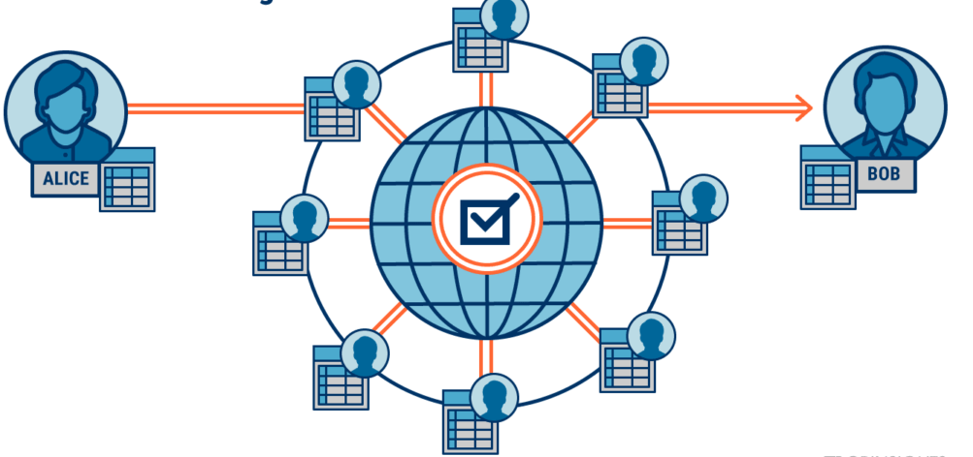
Reason behind using DApp
With a DApp, there are no centralized servers where the data is stored on. Rather, it’s saved to the blockchain. Suddenly, there is no organization that is liable for securing end user data. No organization having to pay staff, maintain servers or other overheads. Since there is no organization involved in operating the network, there is less motivation to sell user data to cover costs. With the data stored on the blockchain, it’s highly secure.

Slide 20
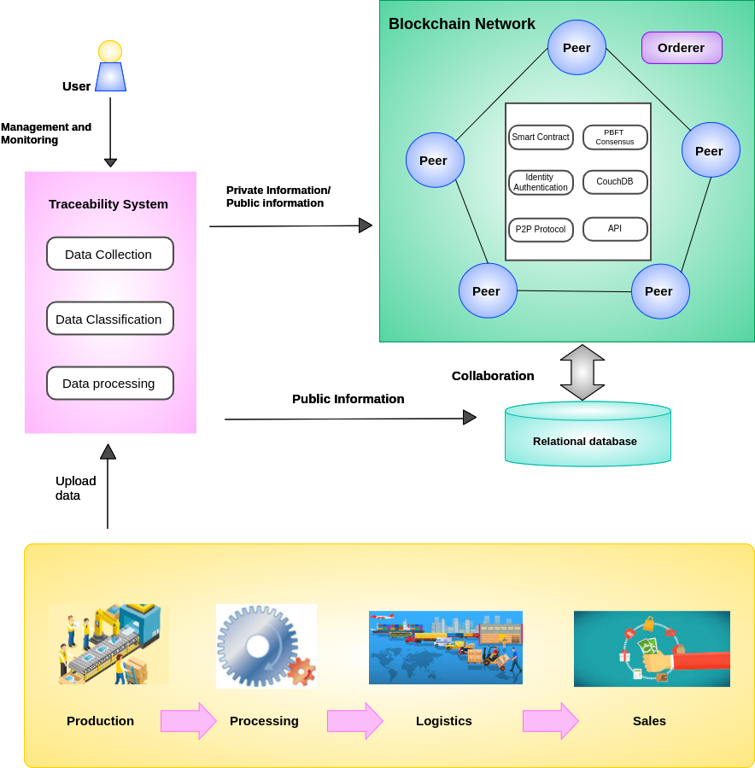
Integration and working of Daap inside SCM
The use of blockchain technology in the supply chain is assumed to be the end-all solution to transparency and visibility. The complexity of the modern supply chain is extensive but blockchain technology has the potential to fix problems within today’s supply chain networks with the help of Daap and smart contract.

Slide 21
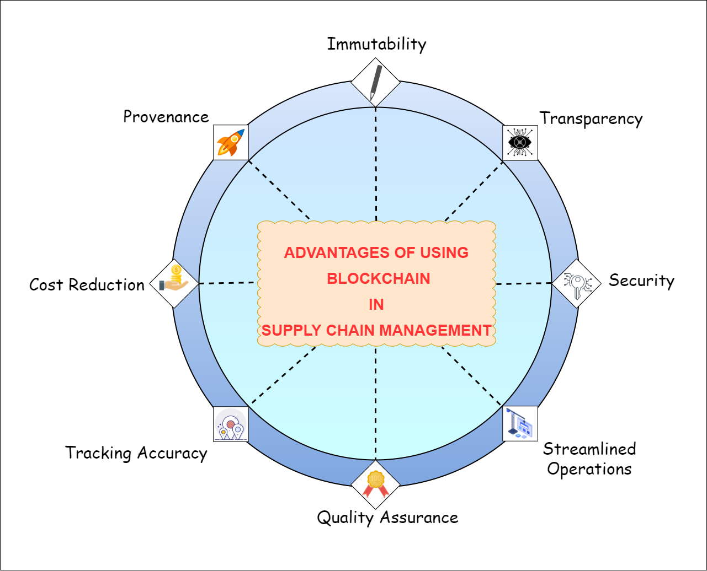
Advantages of BCT enabled SCM using Dapp.
Immutability
Transparency
Security
Streamlined operations.
Quality Assurance
Tracking Accuracy
Cost Reduction
Provenance

Slide 22


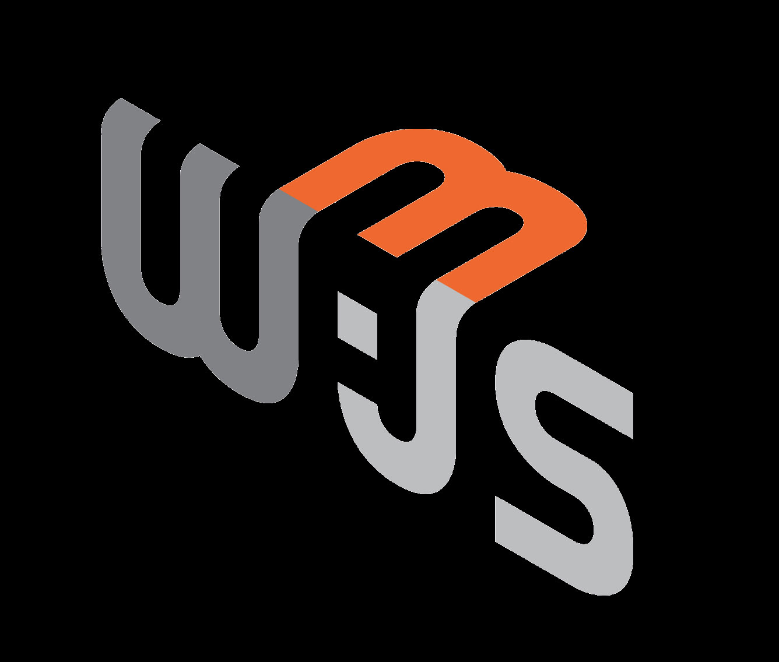
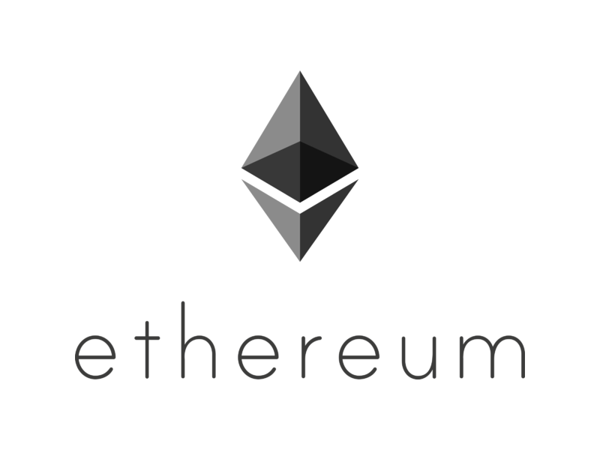

Tech Stack to be used in the project.
JavaScript | Web3.js | Solidity | Ethereum | Metamask

Slide 23
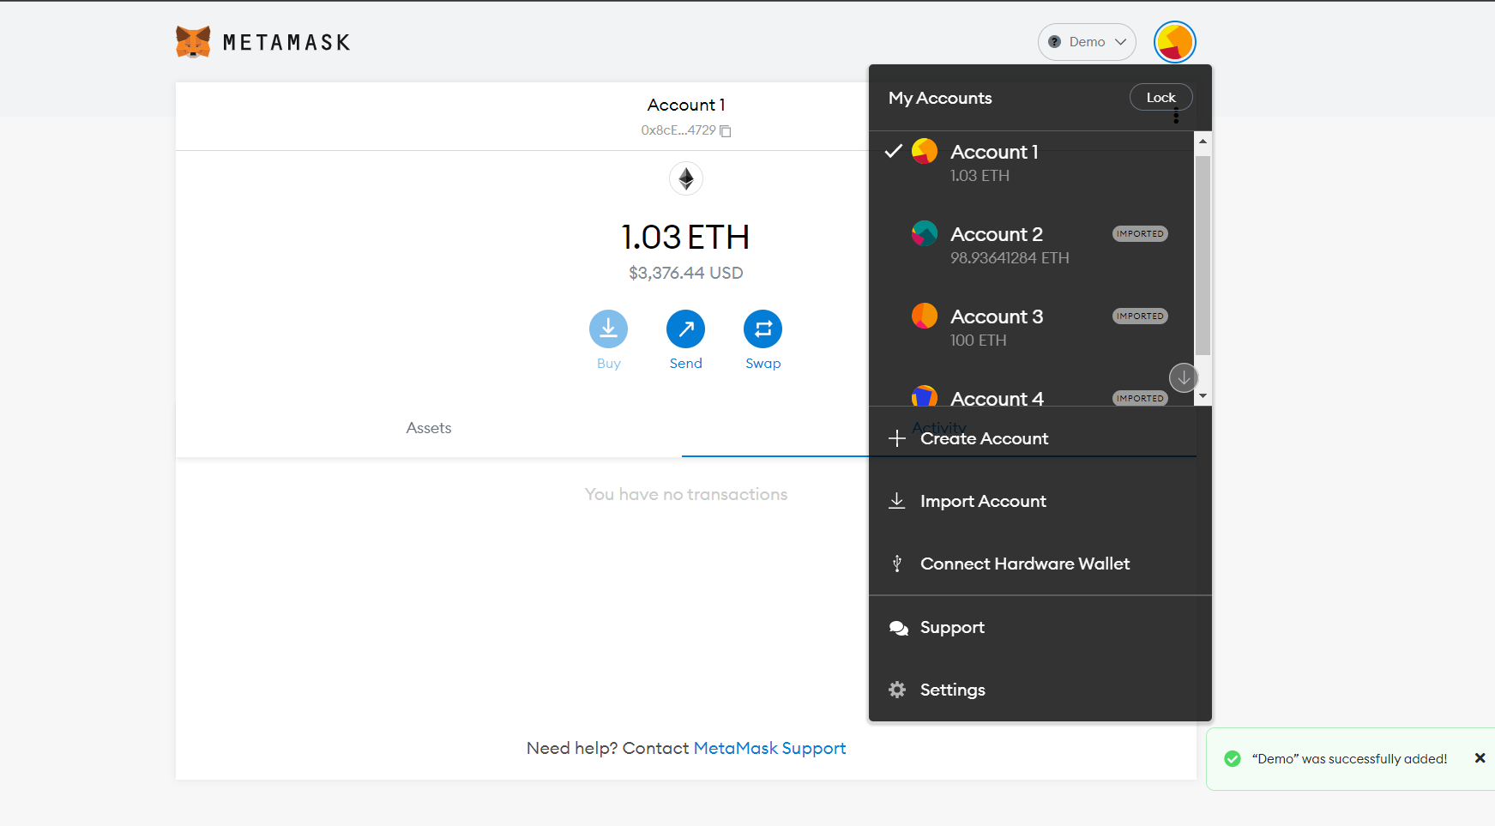
What is Metamask?
MetaMask is a tool enabling user interactions and experience on Web3. It is currently available as a browser extension.
In particular, it handles account management and connecting the user to the blockchain.
MetaMask allows users to manage accounts and their keys in a variety of ways, including hardware wallets, while isolating them from the site context. This is a great security improvement over storing the user keys on a single central server, or even in local storage, which can allow for mass account thefts.
This security feature also comes with developer convenience: For developers, you simply interact with the globally available ethereum API that identifies the users of web3-compatible browsers (like MetaMask users), and whenever you request a transaction signature (like eth_sendTransaction, eth_signTypedData, or others), MetaMask will prompt the user in as comprehensible a way as possible. This keeps users informed, and leaves attackers only the option of trying to phish individual users, rather than performing mass hacks.

Slide 24
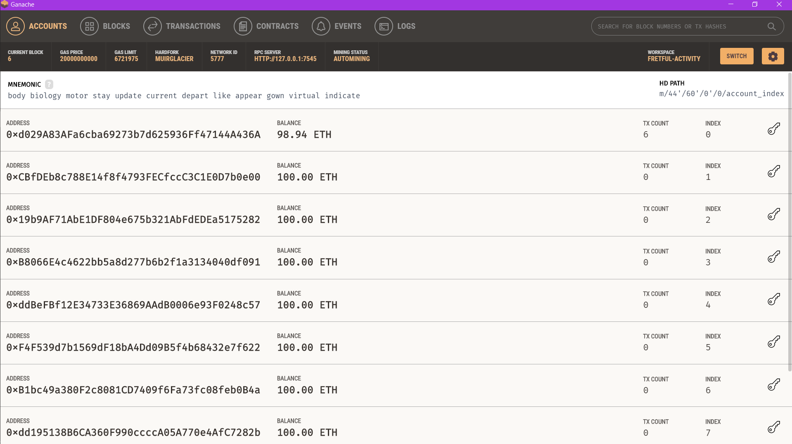
What is Ganache?
Ganache is a personal blockchain for rapid Ethereum distributed application development. We have used Ganache across the entire development cycle, which enabled us to deploy our application. In short we created our own private blockchain on local machine. Which is further linked to meta-mask for carrying out secured transactions.
We have added Ganache Network with MetaMask using Ganache RPC server and Network ID

Slide 25
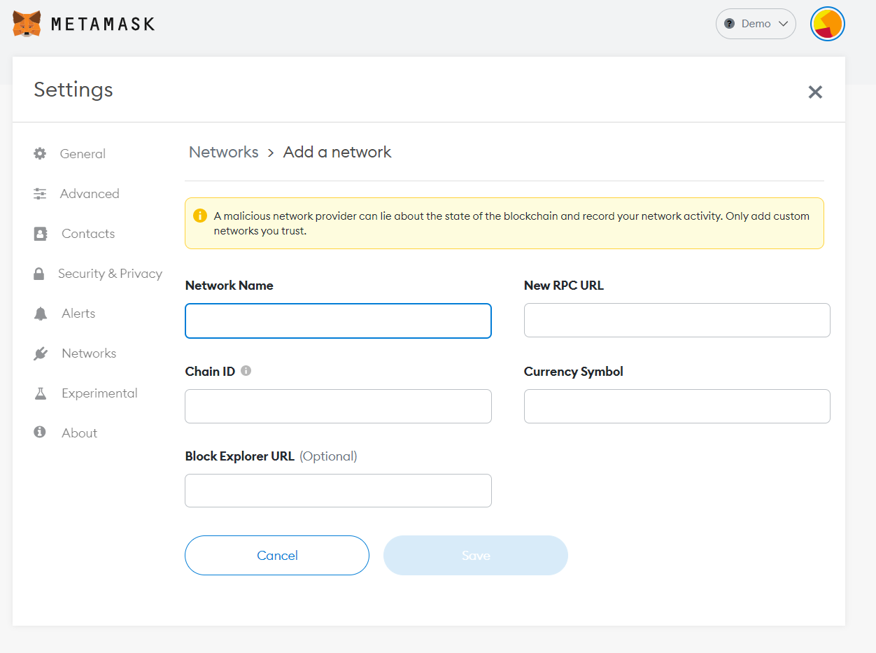
How to create a private network using Metamask?
Network Name: The name that MetaMask will associate with the network.
Network URL(RPC URL): The URL that MetaMask will use to access the network.
Chain ID: The chain ID that MetaMask will use to sign transactions for the network.
Currency Symbol: The currency symbol that MetaMask will use for the network’s native currency.
For example, for the Ethereum Mainnet, the currency symbol is ETH, and for the Gnosis Chain, the symbol is xDAI (retained following their merger).

Slide 26
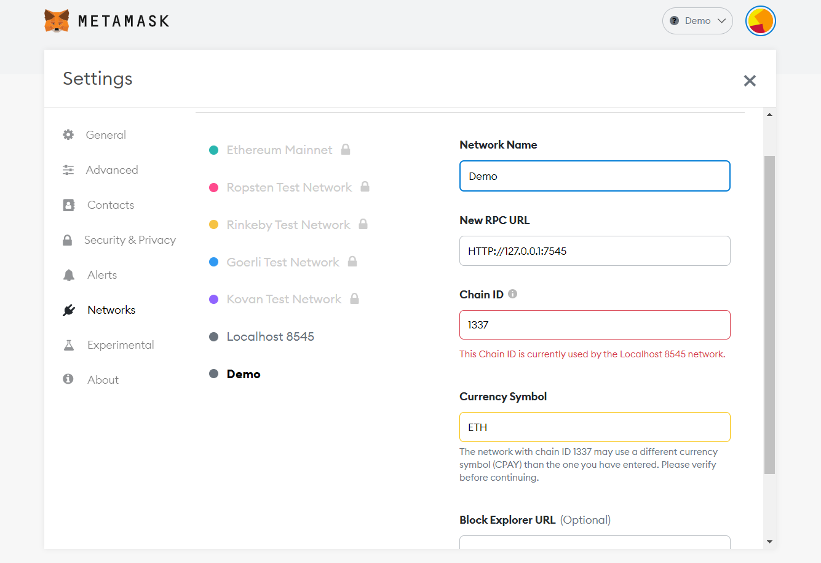
List of public and private networks

Slide 27
Thank You
Thank You

